Slide 1
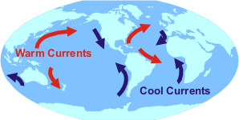
Ocean Currents
Notes:
http://oceanservice.noaa.gov/education/yos/resource/JetStream/ocean/circulation.htm

Slide 2
Ocean Currents
  Warm currents flow away from the equator.
  Cold currents flow toward the equator.

Slide 3
Factors Influencing Currents
Sun
Wind
Coriolis Effect
Gravity

Slide 4
Sun
Energy from the Sun heats the water.
Warm water is less dense than cold water.
Warm water rises, and cold water sinks.
As warm water rises, cold water moves in to replace it.

Slide 5
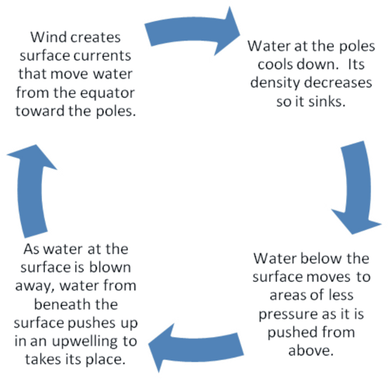
Convection Cycle
Notes:
http://commons.wikimedia.org/wiki/File:Convection_cycle.png

Slide 6
Wind
Just as wind moves from high pressure to low pressure areas, so does the water.
Winds blow across the surface of the water, causing friction.
The water piles up because the surface currents flow slower than the winds.

Slide 7
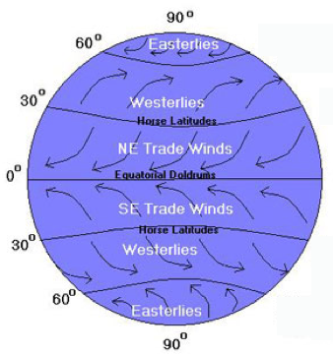
Wind
Notes:
http://oceanmotion.org/guides/cf_2/cf_student_2.htm

Slide 8
Gravity
As water piles up and flows from high pressure to low pressure, gravity will pull down on the water.
This forms vertical columns or mounds of water.
The Coriolis effect causes the water to curve.

Slide 9
The Coriolis Effect
Causes water to move to the right in the Northern Hemisphere
Causes water to move to the left in the Southern Hemisphere

Slide 10
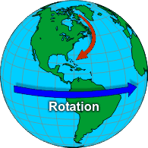
The Coriolis Effect
Notes:
http://www.srh.noaa.gov/jetstream/synoptic/wind.htm

Slide 11
Surface Currents
Make up 10% of oceans’ water
Up to maximum depth of 400 m
Surface ocean currents are caused by the surface wind patterns.

Slide 12
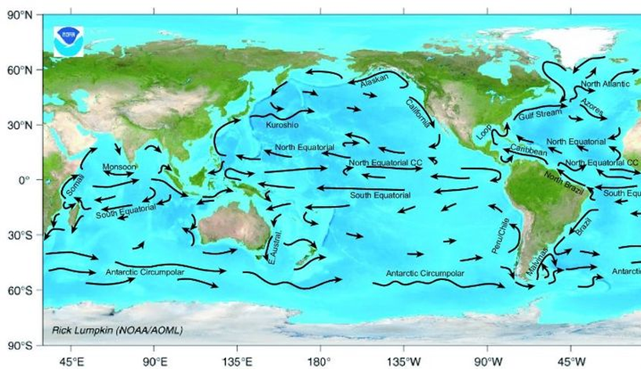
Surface Currents
Notes:
http://upload.wikimedia.org/wikipedia/commons/c/cc/Ocean_surface_currents.jpg

Slide 13
Gyres
                A large system of rotating ocean currents caused by the Coriolis effect
Produce enormous circular currents
Five major locations:
  North Pacific - clockwise
  South Pacific - counterclockwise
  Indian Ocean - counterclockwise
  South Atlantic - counterclockwise
  North Atlantic - clockwise

Slide 14
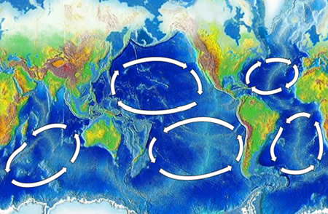
Oceanic Gyres
Notes:
http://commons.wikimedia.org/wiki/File:Oceanic_gyres.png

Slide 15
Gulf Stream
A strong surface current
Begins at the tip of Florida
Flows up the eastern coastline of the U.S.
Crosses the Atlantic Ocean
Causes warmer climate in NW Europe

Slide 16
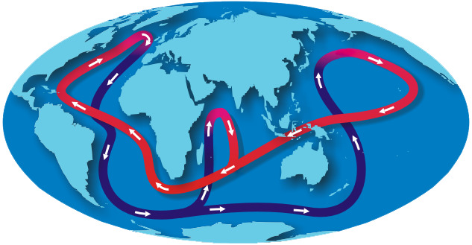
The Great Ocean Conveyor:
Helps maintain Earth’s Balance
Notes:
http://oceanservice.noaa.gov/education/yos/resource/JetStream/ocean/circulation.htm

Slide 17
Deep Water Currents
Make up about 90% of oceans’ water
Differences in density cause them to move.
Differences in density are related to temperature and salinity.
At high latitudes, they sink deep into the ocean basins.
Temperatures are so cold, they cause the density to increase.

Slide 18
Reflective Question
How are ocean currents produced?

Slide 19
Upwelling
As wind blows warmer, less dense, surface water away, colder, deeper, denser waters come to the surface to replace them.

Slide 20
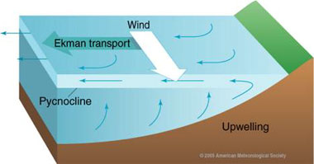
Upwelling
Notes:
http://oceanmotion.org/html/background/upwelling-and-downwelling.htm

Slide 21
El Nino
Abnormally warm surface ocean temperatures off the Pacific coast of South America
Causes more rainfall in Texas
Causes unusual weather patterns across
the globe

Slide 22
El Nino
Starts because the easterly trade winds weaken and allow the warm waters in the Western Pacific to move east toward South America
This changes where the convection current occurs.
Causing rain where it usually doesn't occur and drought where it usually rains

Slide 23
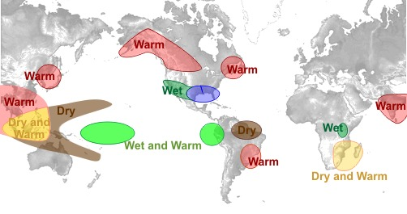
El Nino Winter
Notes:
http://www.srh.noaa.gov/crp/?n=education-elninoandlanina

Slide 24
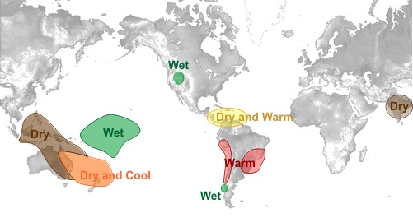
El Nino Summer
Notes:
http://www.srh.noaa.gov/crp/?n=education-elninoandlanina

Slide 25
La Nina
Abnormally cool surface ocean temperatures off the Pacific coast of South America
Causes drought in Texas
Causes unusual weather patterns across
the globe

Slide 26
Ocean’s Effect on Climate
Ocean currents move more slowly than winds.
Oceans hold more heat than the atmosphere and land.
Cold currents will cause nearby coastlines to be cooler.
Warm currents will cause nearby coastlines to be warmer.
Where do the cold currents come from? The warm currents?

Slide 27
Predictable Patterns
How do these currents affect the climate of the coastlines?
Notes:
http://oceanservice.noaa.gov/education/yos/resource/JetStream/ocean/circulation.htm

Slide 28
Reflection Questions
How do our oceans impact climate?

